Slide 1
OpenCV Basics Functions

Slide 2
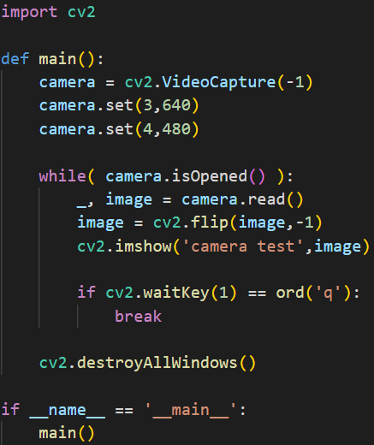
Basic Functions – Open Camera
cv2.VideoCapture(): create a video capture object
cv2.VideoCapture(int index):
Open a camera for a video capturing
cv2.VideoCapture(-1): open raspy camera
cv2.VideoCapture(0): open camera when you use desktop
cv2.VideoCapture(1): open camera that is connected via USB (second camera)
cv2.VideoCapture(const string &filename):
Open a video file or image file sequences
cv2.VideoCapture(‘Resources/Cars.mp4’)

Slide 3
Basic Functions – Open Camera
Set resolution
camera.set(3,640): Set width of the frames in the video stream as 640 px
camera.set(4,480): Set height of the frames in the video stream as 480 px
The parameter 3 and 4 is the enumeration taken from cv2.VideoCaptureProperties for set width and set height
Check the full enumeration in the footer

Slide 4
Basic Functions – Video from Camera
while(camera.isOpened()):
Looping the program. The camera is already in open from cv2.VideoCapture()
camera.read():
reading the current frame from camera
this line is needed so the frames keep updating from the camera
cv2.flip(image,-1):
Flipping the image, 3 possible parameters
cv2.flip(image,0): vertical flipping
cv2.flip(image,1): horizontal flipping
cv2.flip(image,-1): flipping both axes

Slide 5
Basic Functions – Video from Camera
cv2.imshow():
to show the obtained image to a new window
first parameter is the window name
second parameter is the image object that is going to be shown
cv2.waitkey():
display a window for given milliseconds or until any key is pressed
cv2.waitkey(1): wait for 1 milliseconds or any key pressed
cv2.waitkey(0): wait until key pressed
useful when to show image for several seconds and automatically close the window
if cv2.waitKey(1) == ord(‘q’)
become true if the key ‘q’ is pressed, and exit the loop
cv2.destroyAllWindows():
close any opened window after the exit the loop before the program is terminated

Slide 6
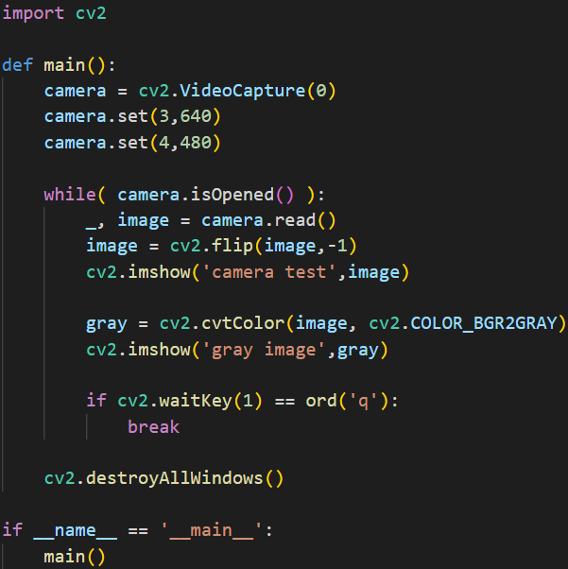
Basic Functions – Change color space
Supposed we already have the image variable (image)
cv2.cvtColor(src,code):
NOTES: there are more parameter besides src and code, we only use fundamental
This function is to convert an image from a color space to another color space
src: the image whose color space is to be changed (image in the left code)
code: the color space code that we want for our image

Slide 7
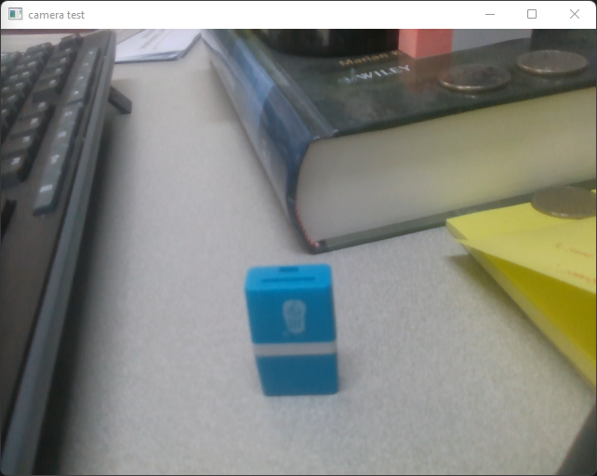
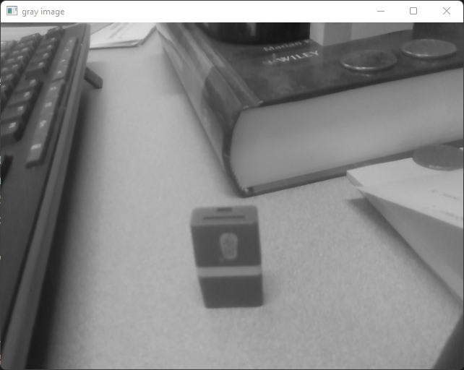
Basic Functions – Change color space

Slide 8
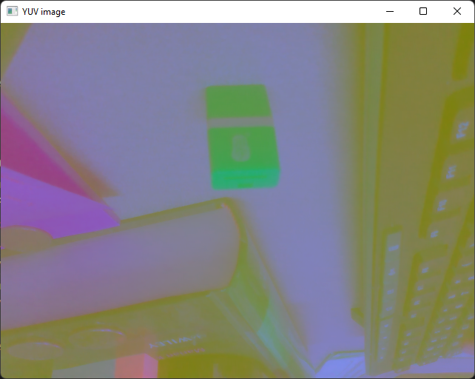
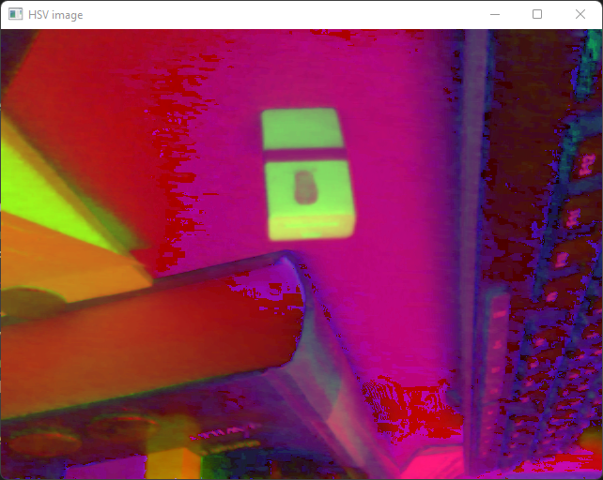
Basic Functions – Change color space
Keep in mind that for colored images, OpenCV use BGR instead of RGB
colored images dimension
(height,width,3)→3 dimensions color
gray images dimension
(height,width)→1 dimension color
color space code:
cv2.COLOR_BGR2GRAY: change BGR to gray
cv2.COLOR_BGR2HSV: change BGR to HSV (hue saturation value) color space → easier for image processing
cv2.COLOR_BGR2YUV: change BGR to YUV (Y: luma/brightness, U and V provide color information) → easier for machine learning

Slide 9
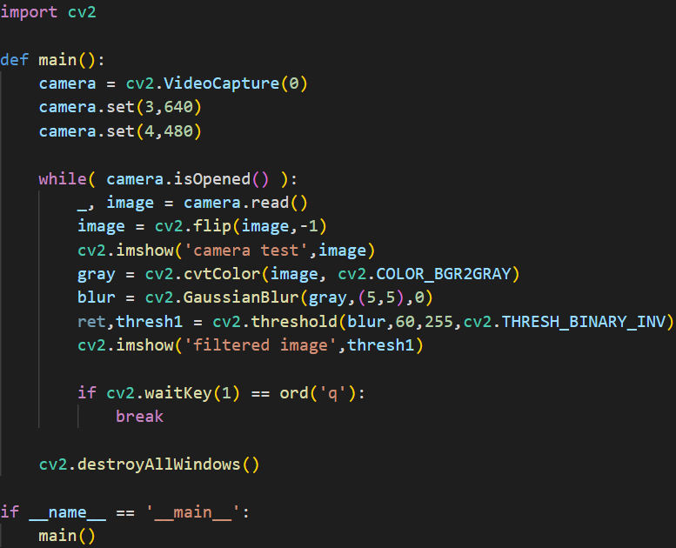
Basic Functions – Image Filtering
To filter the color, it is a best practice to apply Gaussian blur to reduce the level of noise in the image
cv2.GaussianBlur():
One method to apply filter
first parameter: image that we want to apply filter
second parameter: the size of kernel
third parameter: Gaussian standard deviation value in X direction
cv2.threshold():
If the value is smaller than the threshold, it is set to 0, otherwise it is set to a maximum value.
The color value spans between 0 until 255 (0 means darkest color, 255 means brightest color)
first parameter: image variable that we want to thresholding
second parameter: threshold value
third parameter: maximum value (set to 255 for the maximum value for color)
fourth parameter: thresholding type
The most useful one is cv2.THRESH_BINARY and cv2.THRESH_BINARY_INV

Slide 10
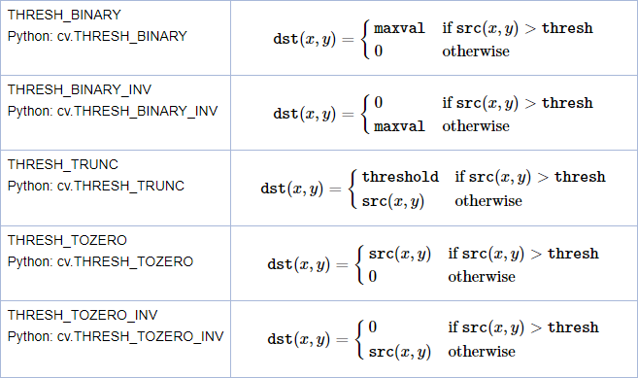
Basic Functions – Image Filtering

Slide 11
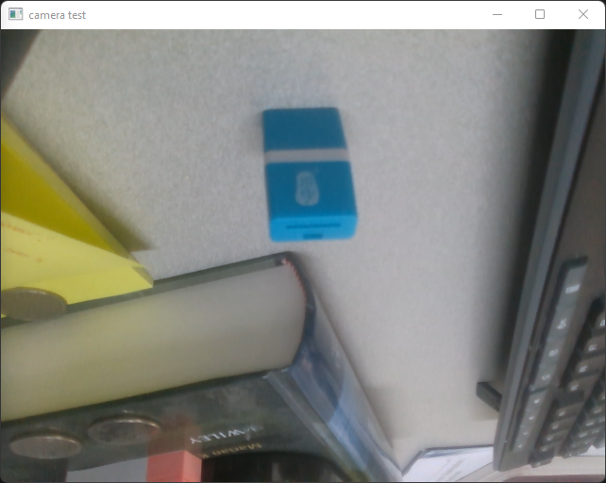
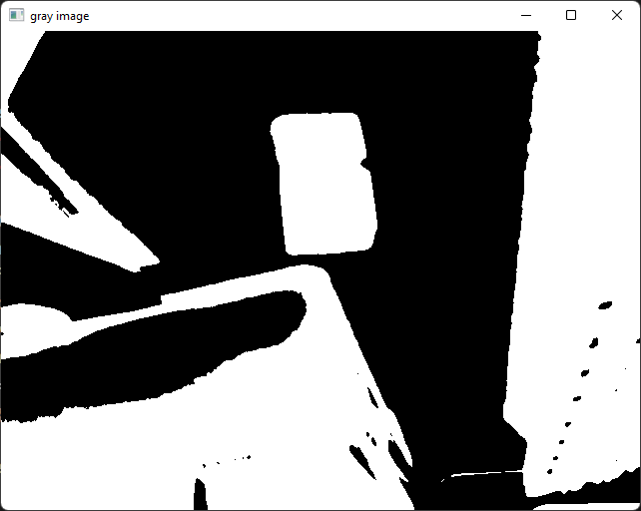
Basic Functions – Image Filtering
using cv2.THRESH_BINARY_INV
Original image is converted to gray space color image, and thresholding with 130 as the threshold value
→ Results: object with value higher than 130 is filtered to black color (0 value)

Slide 12
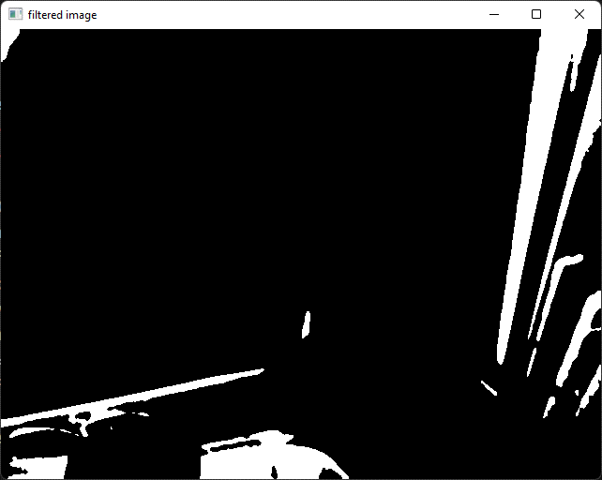
Basic Functions – Image Filtering
using cv2.THRESH_BINARY_INV
Original image is converted to gray space color image, and thresholding with 60 as the threshold value
→ Results: only darker object is filtered

Slide 13
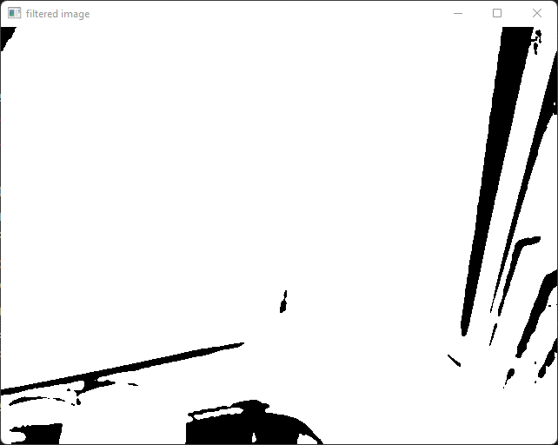
Basic Functions – Image Filtering
using cv2.THRESH_BINARY
Original image is converted to gray space color image, and thresholding with 60 as the threshold value
→ Results: only brighter object is filtered

Slide 14
Contours

Slide 15
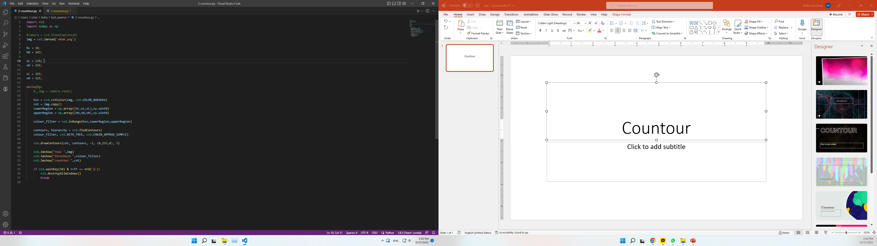
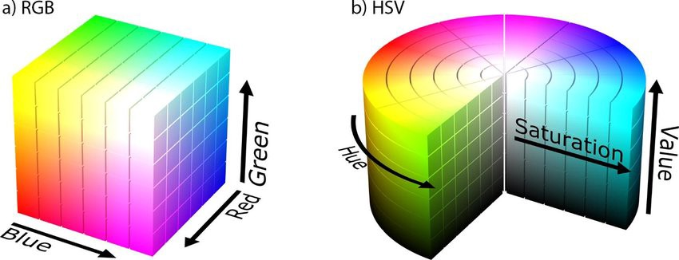
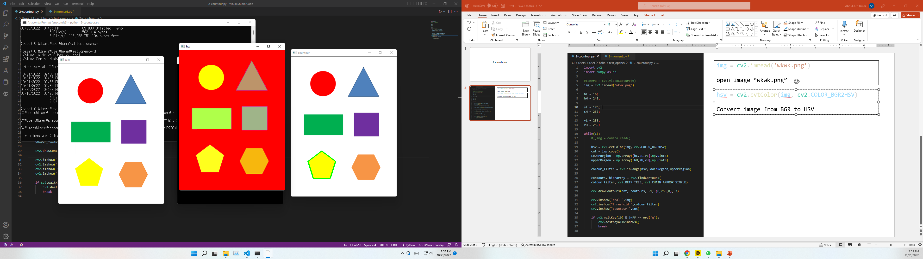
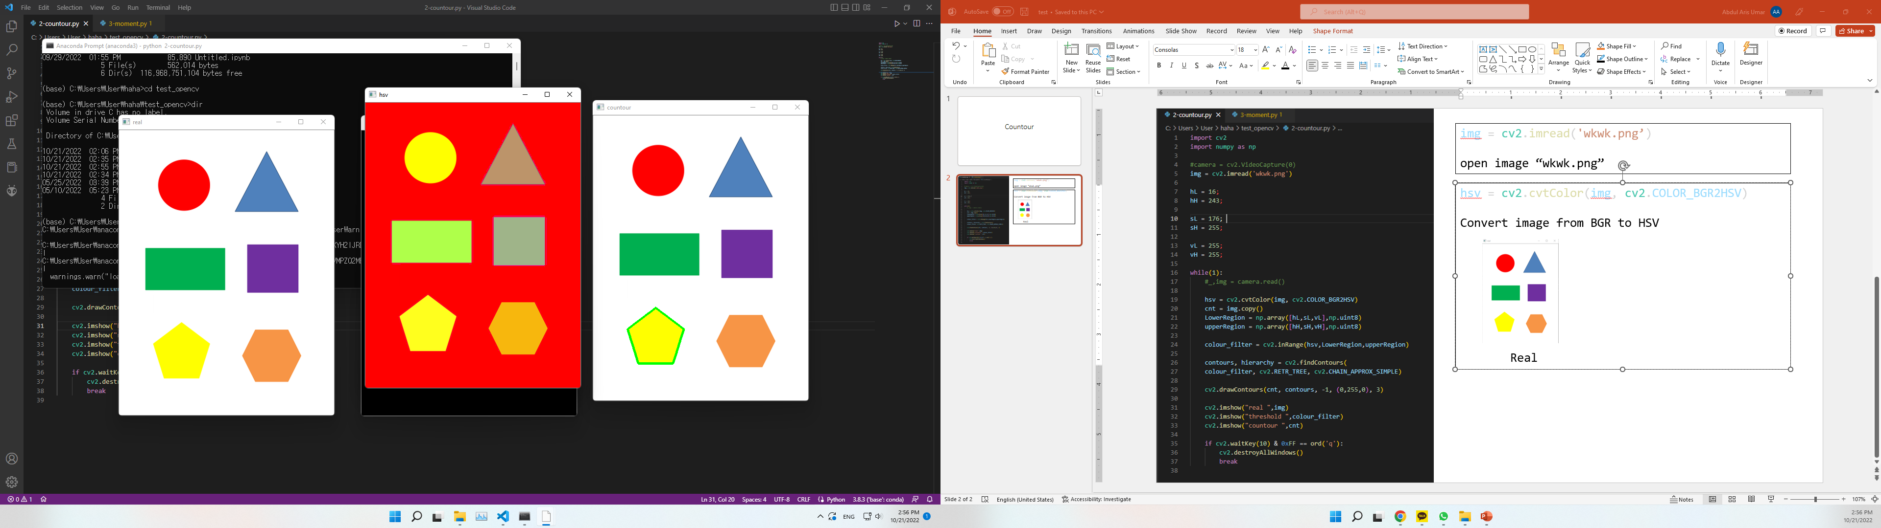
img = cv2.imread('wkwk.png’)
open image “wkwk.png”
hsv = cv2.cvtColor(img, cv2.COLOR_BGR2HSV)
Convert image color space from BGR to HSV

Slide 16
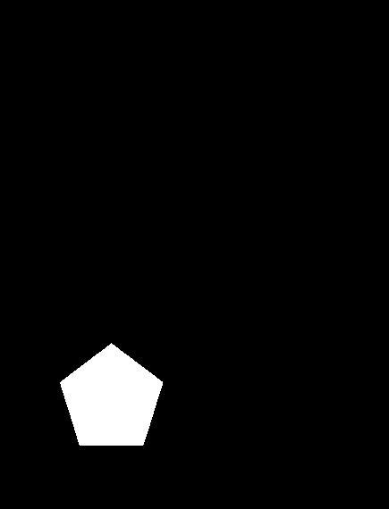
LowerRegion = np.array([hL,sL,vL],np.uint8)
upperRegion = np.array([hH,sH,vH],np.uint8)
Filter HSV picture according to desire range for yellow
146 < hue <= 243 176 < saturation <= 255
255 < value <= 255
colour_filter = cv2.inRange(hsv,LowerRegion,upperRegion)
The color which inside range, will be 1 (white) and not inside the range will be 0 (black)
different colour, different range hue, saturation and value
HSV Colour_Filter

Slide 17
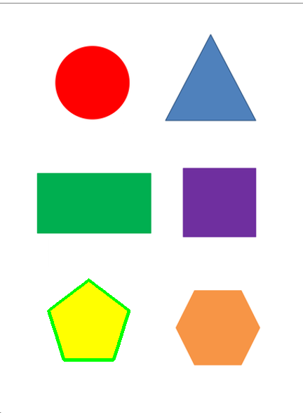
cv2.findContours()
Contours can be explained simply as a curve joining all the continuous points (along the boundary), having same color or intensity.
cv2.drawContours(cnt, contours, -1, (0,255,0), 3)
Draw line according to continuous points in the contours
Real contour

Slide 18
Moment

Slide 19
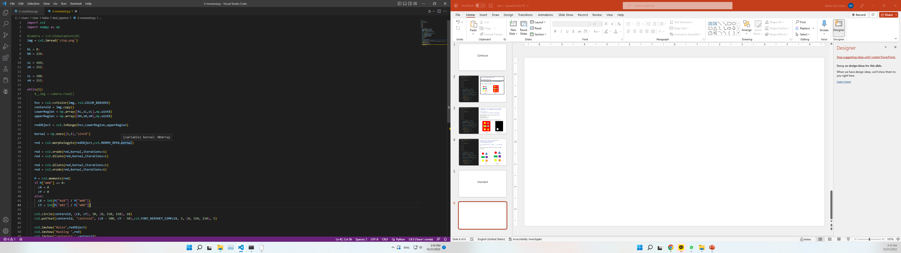
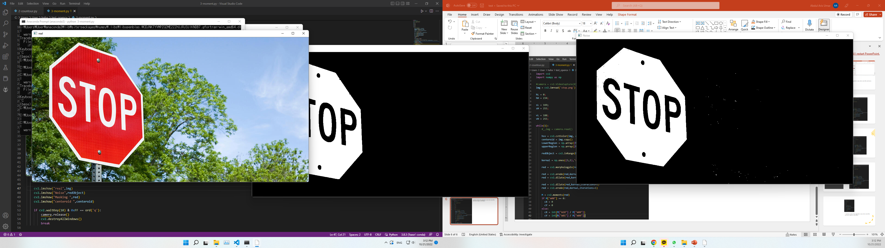
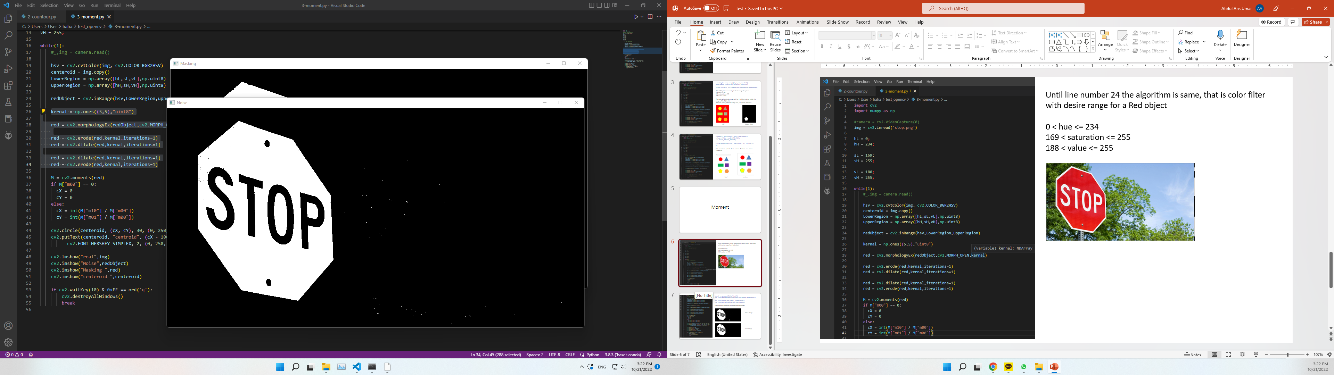
Until line number 24 the algorithm is same, that is color filter with desire range for a Red object
0 < hue <= 234 169 < saturation <= 255
188 < value <= 255

Slide 20
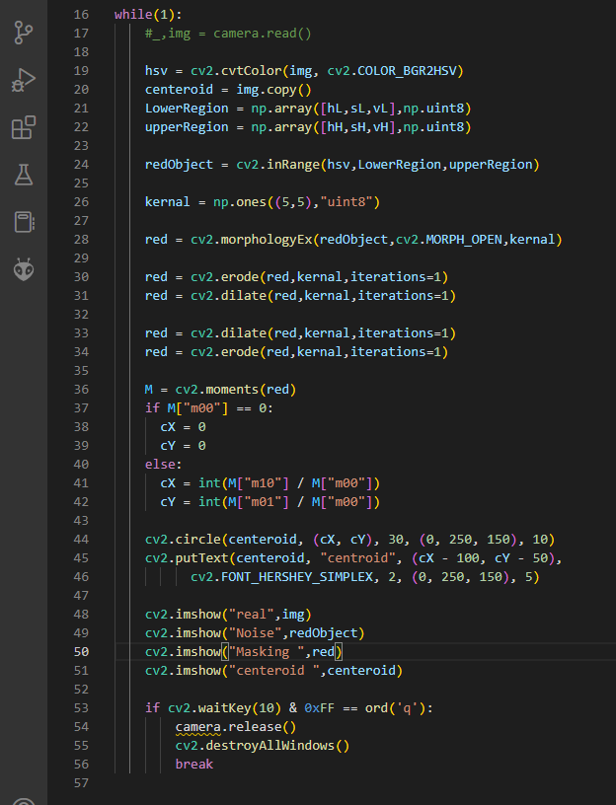




cv2.morphologyEx()
closing small holes inside the
foreground objects
cv2.erode()
it erodes away the boundaries of
foreground object (Always try to
keep foreground in white)
cv2.dilate(red,kernal,iterations=1)
It is just opposite of erosion. Here,
a pixel element is '1' if at least
one pixel under the kernel is ‘1’

Slide 21
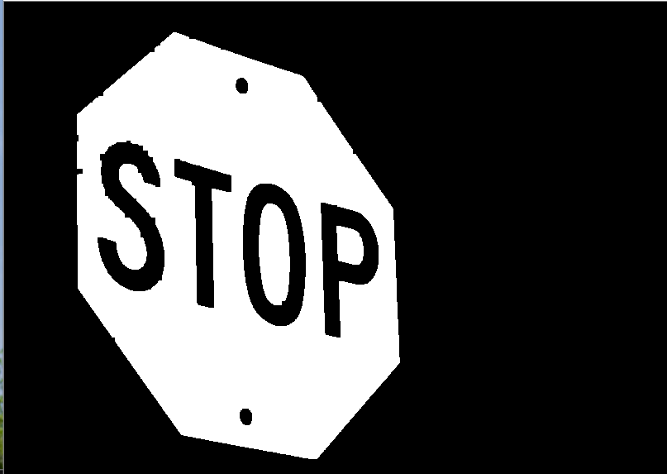
kernal = np.ones((5,5),"uint8")
Setting kernel 5x5 pixel from color filter image
red = cv2.morphologyEx(redObject,cv2.MORPH_OPEN,kernal)
red = cv2.erode(red,kernal,iterations=1)
red = cv2.dilate(red,kernal,iterations=1)
Erase the noise below 5x5 pixel from color filter image, 5x5 is from kernel value
Noise Image
Clear Image

Slide 22
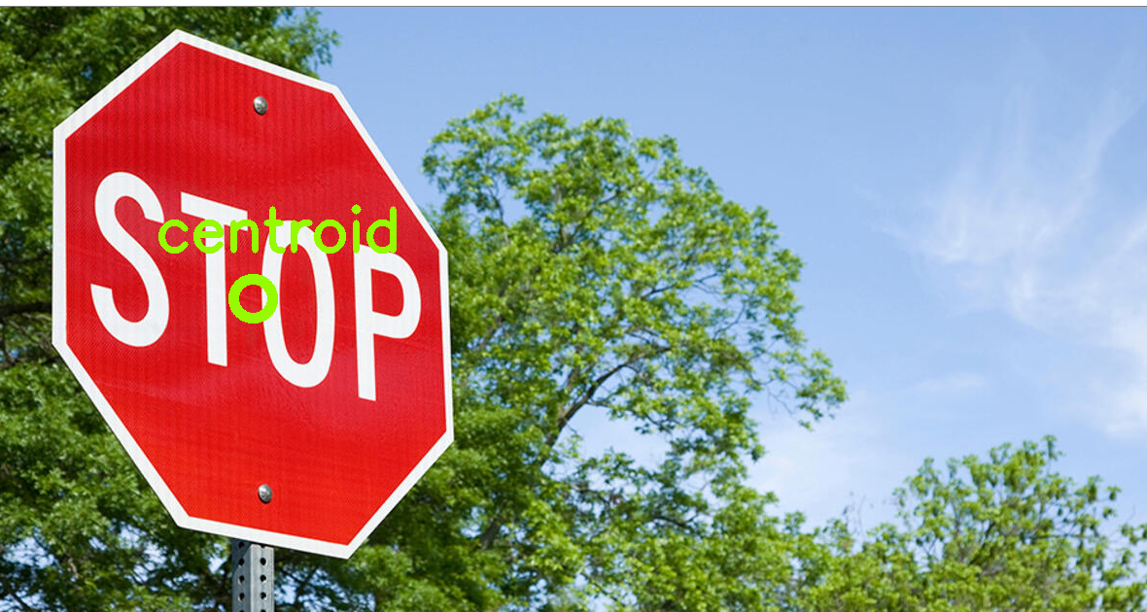
This algorithm is for find Center position of filtered object in XY-Coordinate
M = cv2.moments(red)
Get the area (pixel group) from the object contour
if M["m00"] == 0:
cX = 0
cY = 0
else:
cX = int(M["m10"] / M["m00"]) get center position in X-coordinat
cY = int(M["m01"] / M["m00"]) get center position in Y-coordinat
cv2.circle() Draw Circle and text in central position
cv2.putText()

